Slide 1
OPENeP - An Open Standards Approach To An Integrated Digital Care Record
Plymouth Hospitals NHS Trust
Andy Blofield, Director of IM&T (CIO)

Slide 2
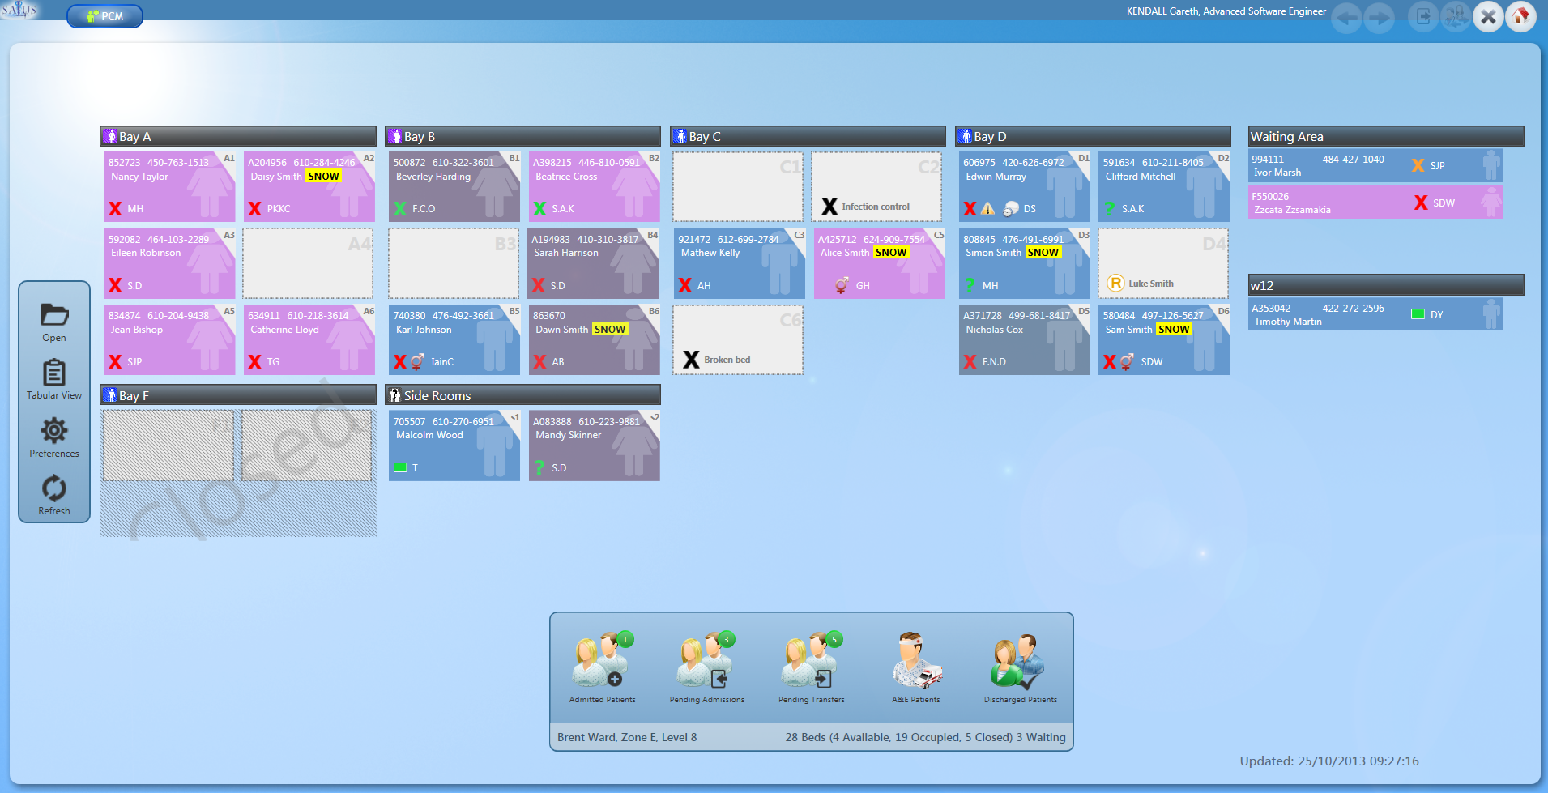
Our Starting Point
“Best of Breed + Interfacing since 1999”
Patient Administration System & ED
Open Standards Interface Engine
Order Communications
PACS/RIS
SALUS
190 Departmental Clinical Solutions

Slide 3
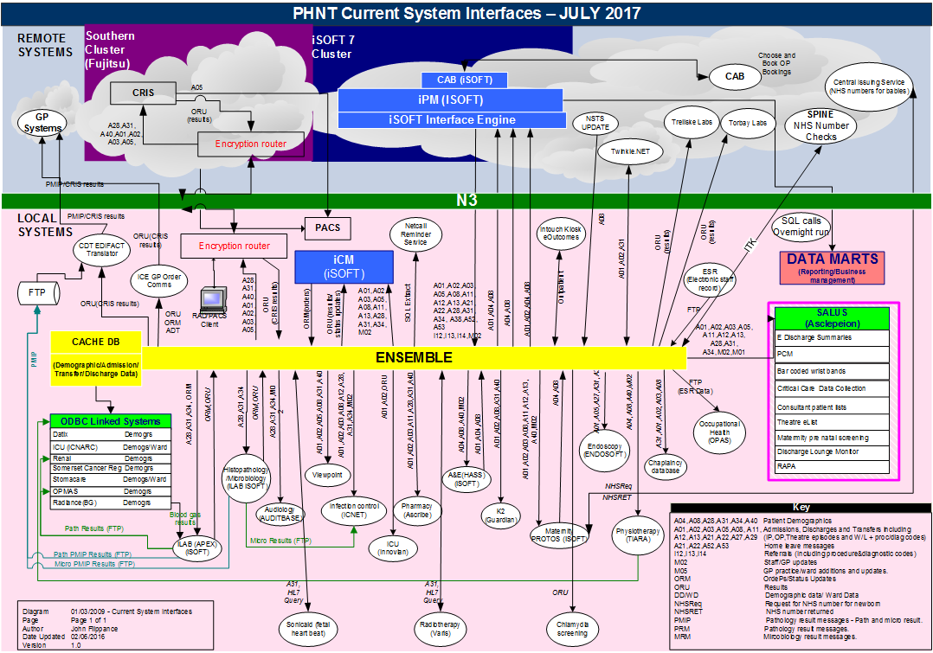

Slide 4
Issues (Other than complexity)
Proprietary … Vendor “lock in”
Data migration nightmare
Strategic fit?

Slide 5
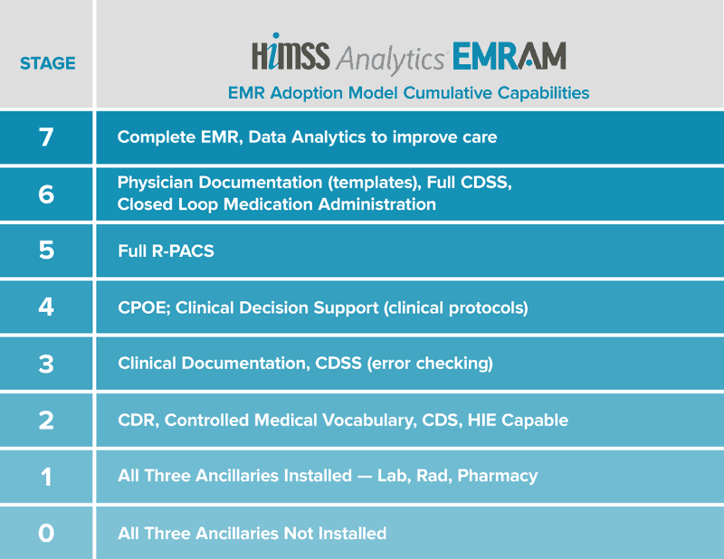
The End Game
A single Integrated Digital Care Record (IDCR)
The Healthcare Information and Management Systems Society (HIMSS) is an American not-for-profit organization dedicated to improving health care in quality, safety, cost-effectiveness, and access through the best use of information technology and management systems. It was founded in 1961 as the Hospital Management Systems Society.
It is now headquartered in Chicago, Illinois. The society has more than 50,000 individual members, over 570 corporate members, and more than 225 not-for-profit organizations.
(OPENeP)
(eForms)
(+ eNotes)
Clinical Decision Support (clinical protocols) + EWS
(eObservations)

Slide 6
Options
“Big Box” IDCR Solution
(EPIC, Cerner, Lorenzo et al.)
Open Standards Approach
Fits with our strategic approach
Incremental implementation
Re-invigorates the SME marketplace
Proven deployment and benefits model
IDCR out of the box
Consistent User Interface
No Vendor “lock in”
Proprietary … Vendor “lock in”
No Data migration
Data migration nightmare
Incremental investment (££)
££££

Slide 7
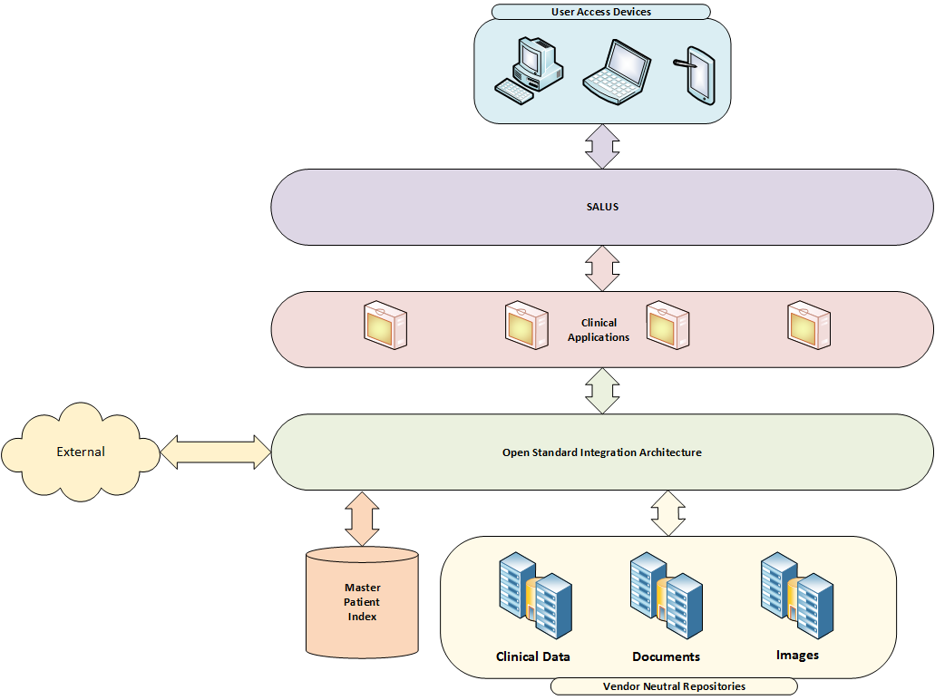
Our Vision

Slide 8
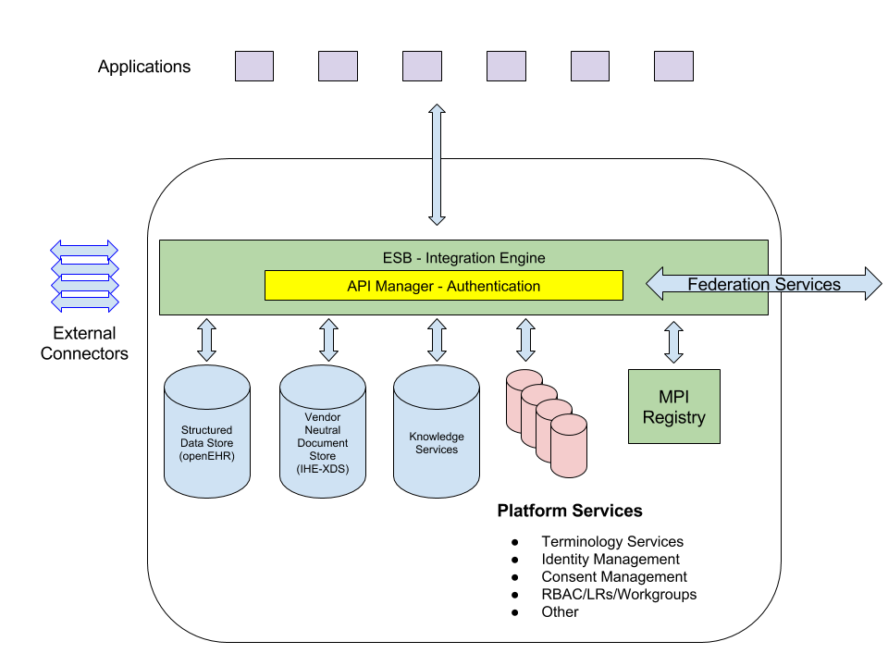
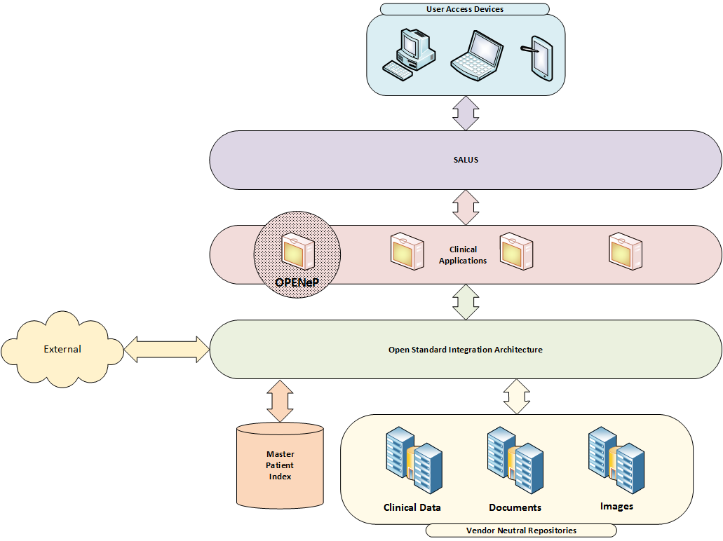
Marand Approach

Slide 9
Today
UK First of type for OPENeP
Open source EPMA solution (Think!Meds)
Utilises the openEHR standards based repository
Accessed via Marand Think!EHR platform
Delivered through SeeEHR
Apperta Foundation
Source code custodianship
Software safety case
CGI (solution integrator)
Implementation and support for OPENeP & Think!EHR
Working up development and support for SeeEHR

Slide 10
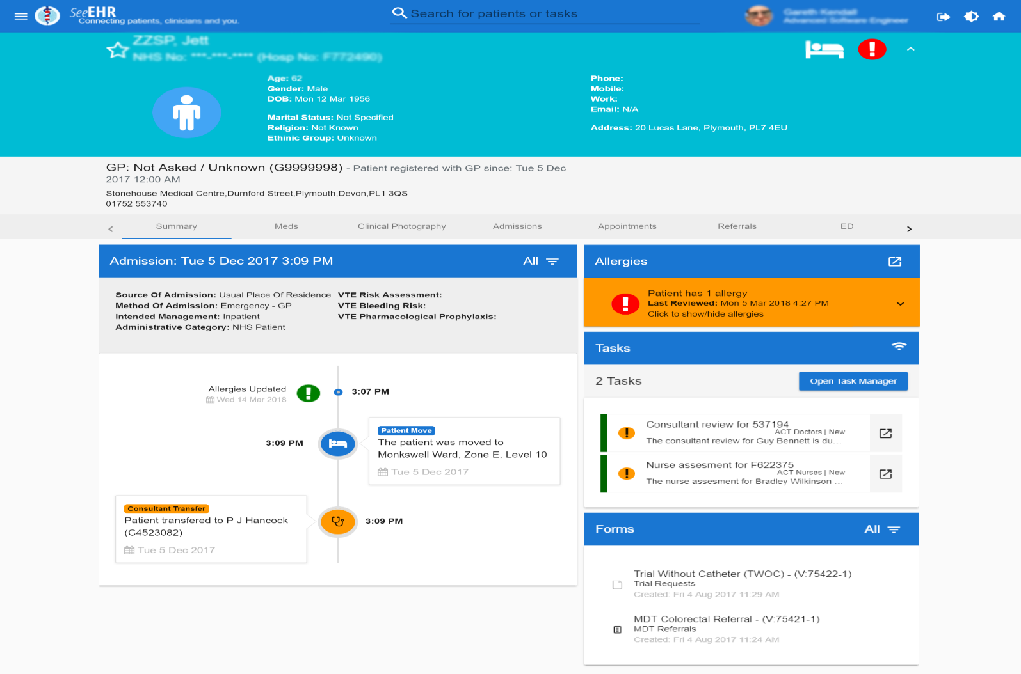
Today

Slide 11
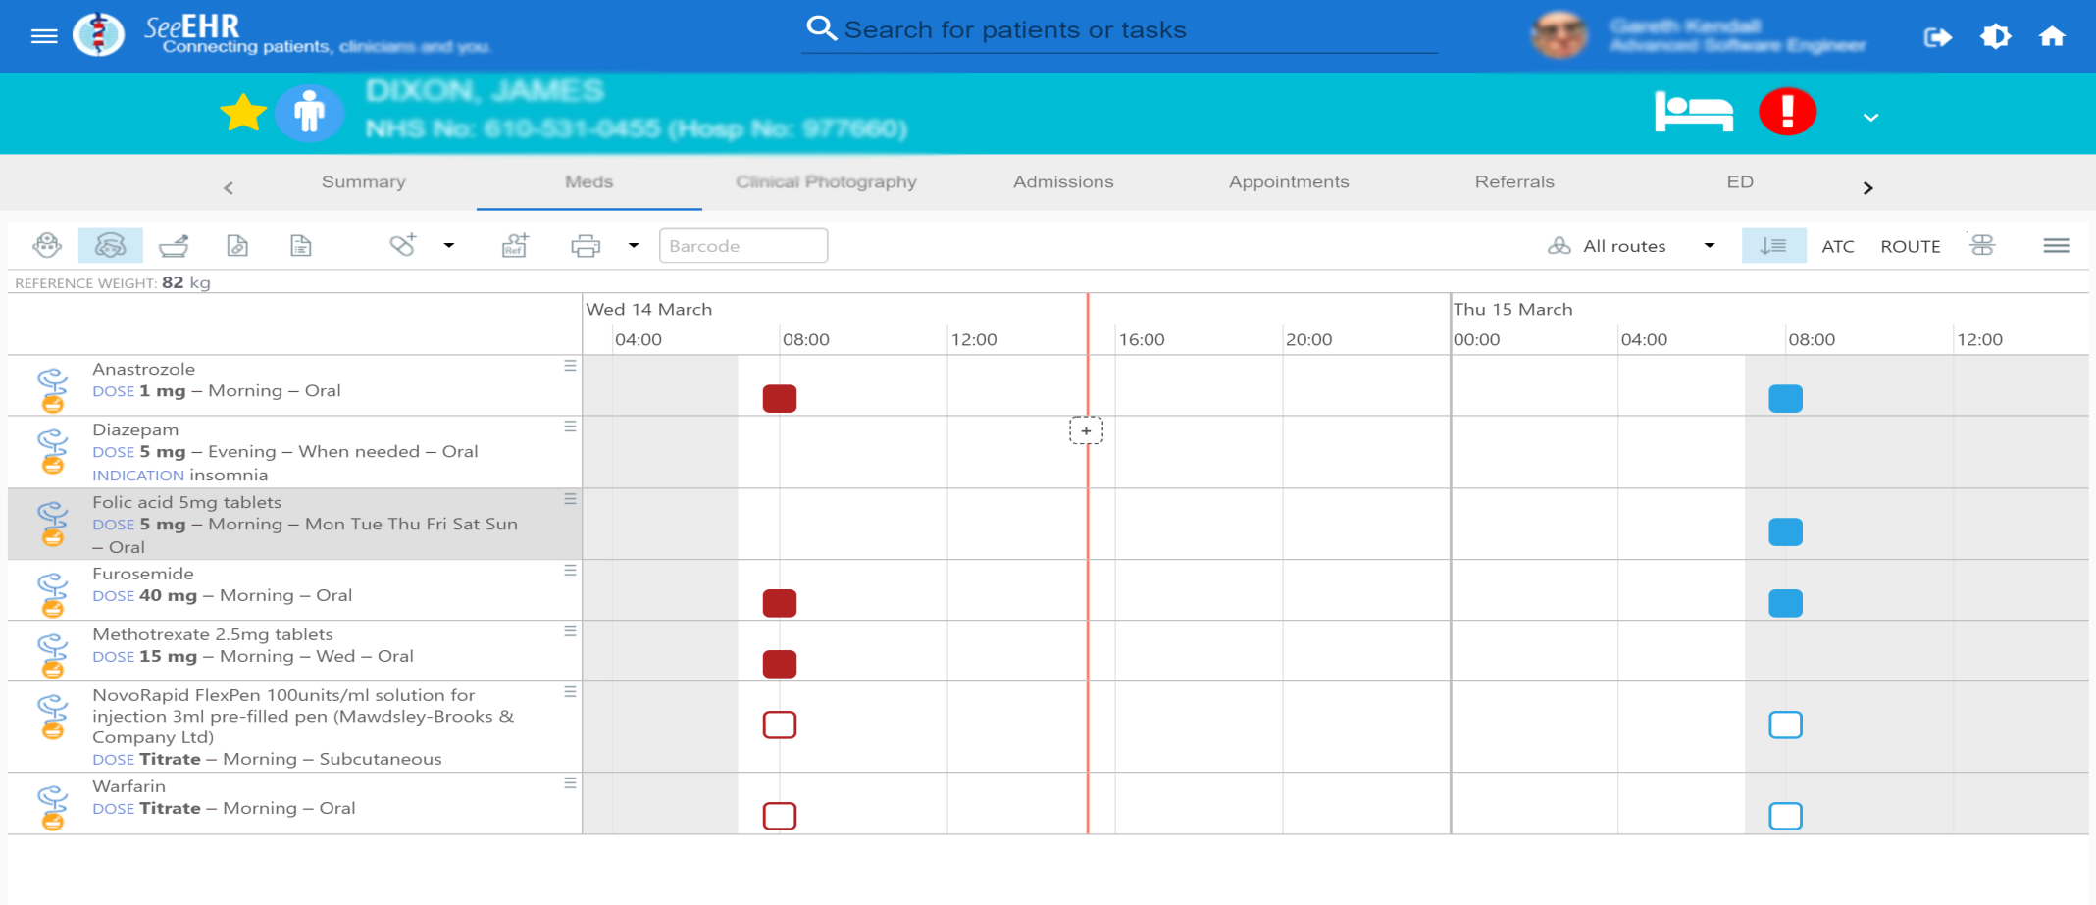
Today

Slide 12
To come
Order Communications
Electronic Observations
SeeEHR open source & openEHR
Packaged deployment opportunities
Ecosystem development
Local Investment
Local SME’s
Connections with partners (Education)
National and Global developments

Slide 13
OPENeP - An Open Standards Approach To An Integrated Digital Care Record
Andy Blofield, Director of IM&T (CIO)
andyblofield@nhs.net

